Slide 1

Welcome to

Slide 2

How It Works
Home
Features
Download
About Us
Support
Connect
Chat
Share
Fostering meaningful interactions and effortless expression in every moment.

Slide 3

How It Works
Home
Features
Download
About Us
Support
Identity & Equality
Celebrating individuality while fostering a world of equal connections and shared voices.

Slide 4
How It Works
Home
Features
Download
About Us
Support
“At Rocon, we redefine communication with a modern touch—offering seamless connections, engaging chats, and the power to share like royalty. Whether you're looking to bond with friends, network professionally, or express yourself creatively, Rocon empowers you to do it all.”
- Okonkwo C. Noel (Developer)

Slide 5

How It Works
Home
Features
Download
About Us
Support
End-Point Surveillance & Security
We Pride in our implementation of the dynamism in allowing the individual to be the sole point of Privacy and we therefore employ dynamism in authorizing client that make use of this platform.

Slide 6
Soo… What are you waiting for?!
GET THE APP

Slide 7
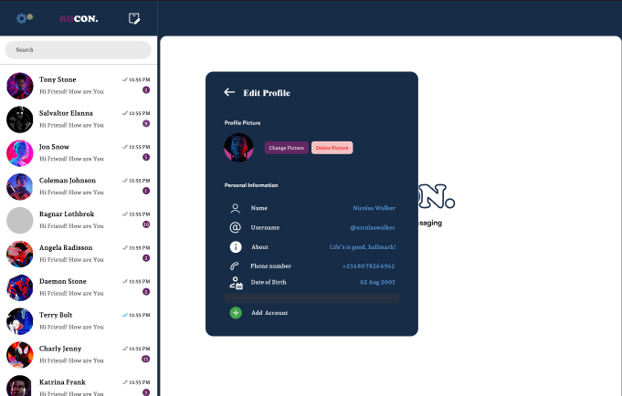
How It Works
Home
Features
Download
About Us
Support
Template 1
Content template

Slide 8
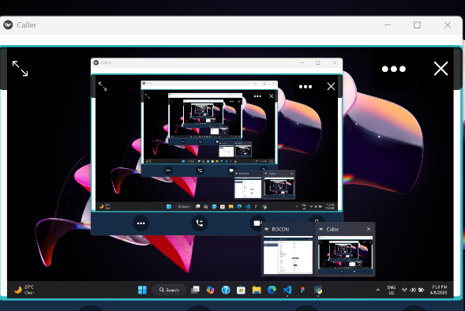
Template 2
Content 2

Slide 9
Template 1
Content template
Template 2
Content template

Slide 10
The only available version for now is on Windows
DOWNLOAD FOR WINDOWS
Notice : This is a pre-launch version (0.1.0). The actual version would come out soon enough

